Slide 1
GERMAN AUTUMN
Stig Dagerman

Slide 2
German Autumn (original title: Tysk höst) is a book published in 1947 collecting a series of journalistic essays by Swedish novelist Stig Dagerman. Written during the fall of 1946, it depicts life in the war-torn country in the immediate aftermath of World War II. The 2010 Swedish edition has an introduction by Nobel Prize in Literature. It was adapted into the 2008 French documentary film 1946, “automne allemand” that uses archival footage from post-war Germany to illustrate Dagerman's text.

Slide 3
In late 1946, Stig Dagerman was assigned by the Swedish newspaper Expressen to report on life in Germany immediately after the fall of the Third Reich.
First published in Sweden in 1947, German Autumn, a collection of the articles written for that assignment, was unlike any other reporting at the time. While most Allied and foreign journalists spun their writing on the widely held belief that the German people deserved their fate, Dagerman disagreed and reported on the humanness of the men and women ruined by the war—their guilt and suffering.

Slide 4
Dagerman was already a prominent writer in Sweden, but the publication and broad reception of German Autumn throughout Europe established him as a compassionate journalist and led to the long-standing international influence of the book.

Slide 5
Stig Halvard Dagerman (5 October 1923 – 4 November 1954) was a Swedesh author and journalist prominent in the aftermath of World War II.

Slide 6
Stig Dagerman was in born Upsala County, Sweden. He later took his father's surname Jansson and then changed his name to Stig Dagerman in his teens. In the course of five years, 1945–49, he enjoyed success with four novels, a collection of short stories, a book about postwar Germany, five plays, hundreds of poems and satirical verses, several essays of note and a large amount of journalism. He died in 1954, having closed the doors of the garage and run the engine.

Slide 7
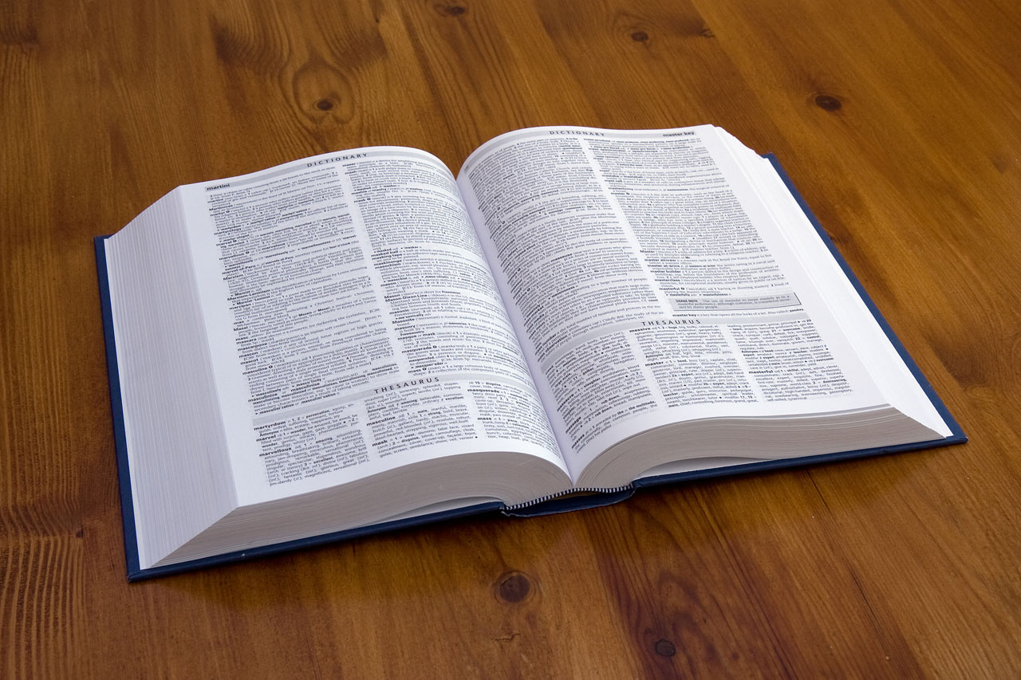
Dagerman wrote with beautiful objectivity. Instead of emotive phrases, he uses a choice of facts, like bricks, to construct an emotion.
— Graham Greene

