Slide 1
la librería del señor livingstone (mr livingstone's bookshop)
Monica Gutierrez

Slide 2
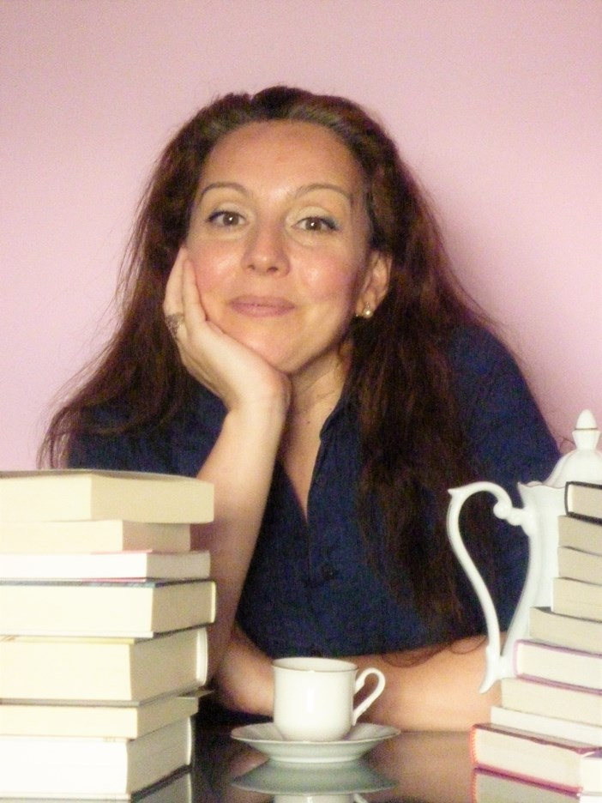
The author…
Monica Gutierrez was born in Barchelona and she has studied journalism and history. She has also been awarded for her poems and her short stories and she has already written four novels. Mr Livingstone’s bookshop was published during quarantine in Spain. It is still translating and is going to be published in many languages.

Slide 3
Description
Could a small London bookstore change someone’s life? This is a story for those who have ever felt that literature saved them. Agnes Martí is a young archaeologist who moves to London in search of a new opportunity. Shortly after arriving in the city as she strolls through the Temple district, she is surprised by a sudden downpour and takes refuge in a very special bookstore: Moonlight Books. Edward Livingstone is looking for an assistant, and in the time it takes Agnes to dry off and sit down for a cup of hot tea, they both realize that it is no accident that she is the one who walked through the door at that time. As the days go by, Agnes starts to discover her new boss’ grumpy nature, the eccentricities of her regular clientele, and the magic of this charming bookstore. Until one day, one of the most treasured books on Moonlight Books' shelves disappears and inspector John Lockwood enters the scene to take over the investigation and shake Agnes' quiet and peaceful life.

Slide 4
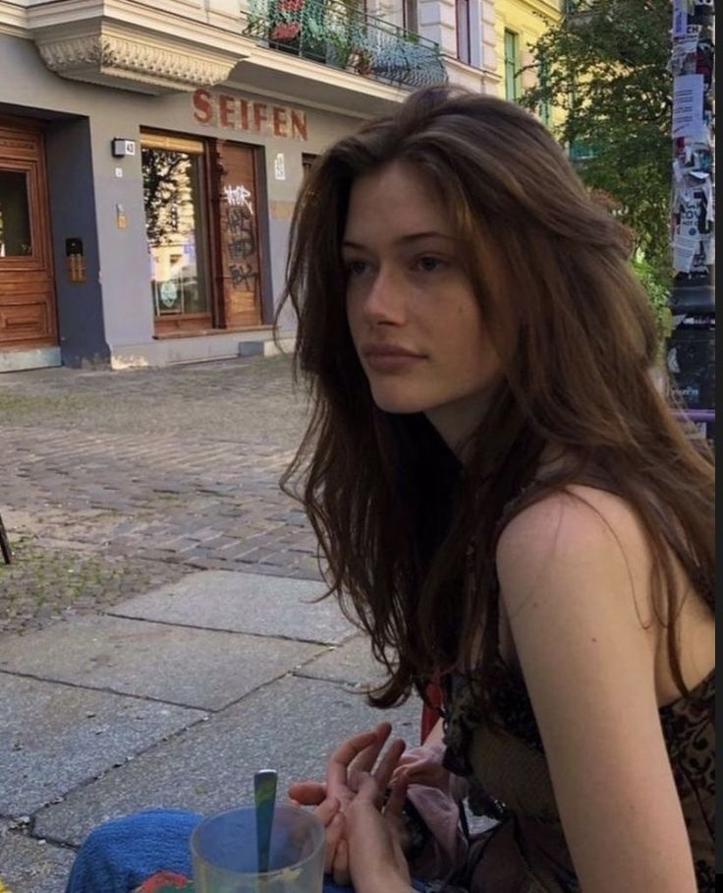
Agnes Marti
She is an archeologist who moved to London in order to find a better job. She is passionate about her profession and hardworking. She loves books, she is very romantic and loves walking barefoot. She looks like a fairy, she is kind, caring and has a big character development.

Slide 5
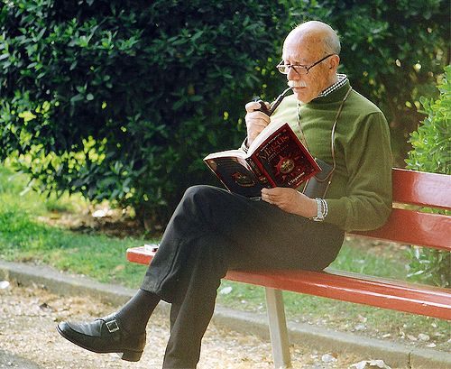
Mr. Livingstone
He is passionate about books, he owns a “magical” bookstore which he adores and he has Agnes like his child. He is a grumpy old man and knows his clients’ personalities pretty well. He is a great judge of character and he has a wide knowledge about the books he sells and their writers. Additionally, he loves deeply.

Slide 6
Other characters…
Oliver Twist is a boy with big dreams who loves astronomy, he is a kind soul and very loveable.
Sivonne Clark is a publisher, she loves mr Livingstone and Oliver. She is kind hearted and a very good companion.
John Lockwood is a policeman who is very romantic, hardworking and immediately fell in love with Agnes.

Slide 7
Our point of view…
While reading the book we fell in love with the magical atmosphere of the book and its characters. This book teach you a lot about self improvement, getting out of your comfort zone and your daily routine and through hard work eventually you find what you were honestly searching for. Through this novel we can admire how literature has a positive impact on peoples life and how unexpectedly love can find you.

